Slide 1

Yet Another VU-meter
A self-training project

Slide 2


Step 1 – Accessing sound info & microphone
Simple configuration file
Simple command line
Select sound card (Mixer.Info)
Access line level (DataLine.Level)
Display level as text
Console
PC
config
app
JVM
Not implemented
/ library bug?
Win64
https://www.youtube.com/watch?v=T52l6ss3SFs
https://docs.oracle.com/javase%2Ftutorial%2F/sound/accessing.html
https://docs.oracle.com/javase/tutorial/sound/sampled-overview.html

Slide 3
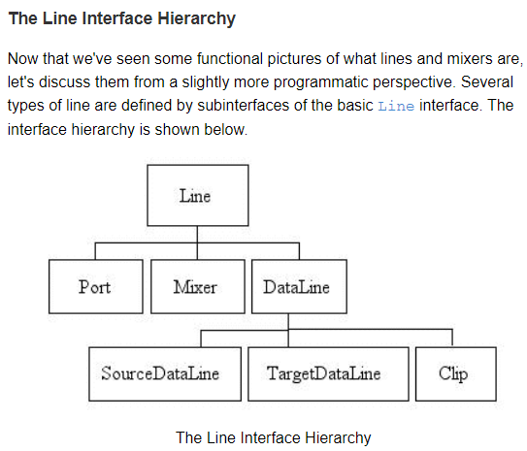
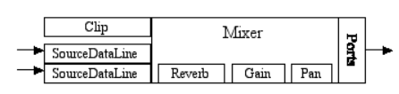
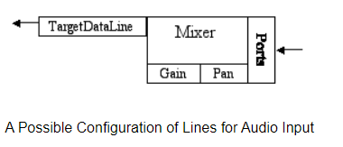

Slide 4
Limitations
DataLine.Level not implemented -> monitor buffer
Output ports cannot be monitored -> duplicate to input (virtual microphone)
eclipse 2023-12 will not say if the default JDK is too old (make sure the system’s JDK is 17+)

Slide 5
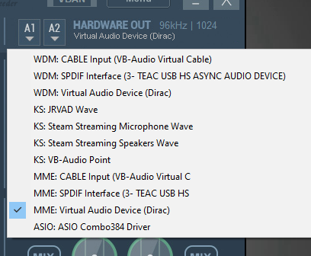
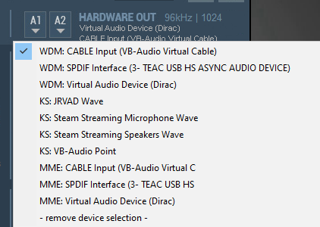
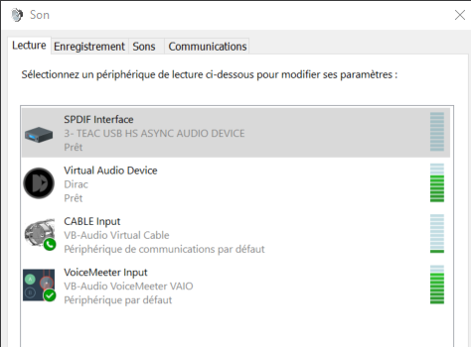

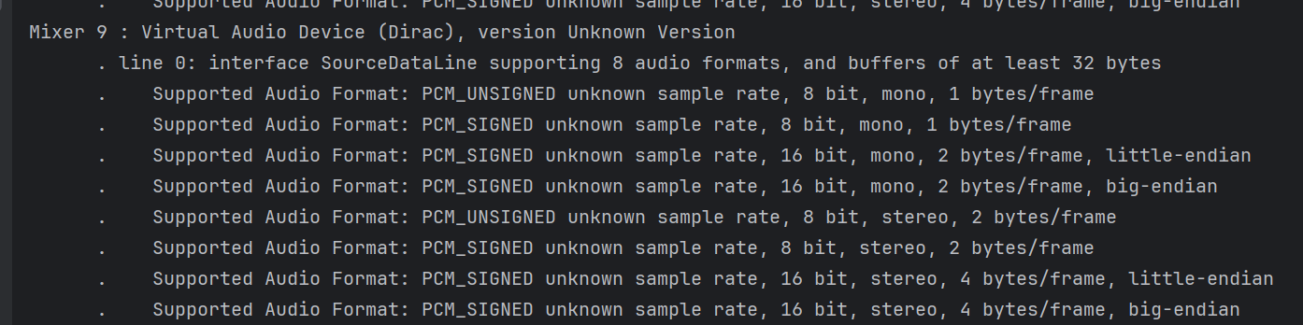
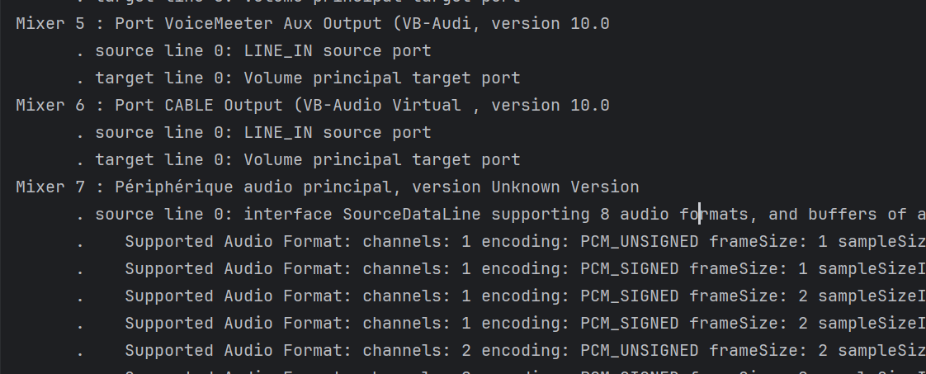
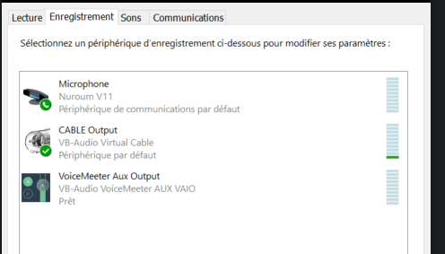
Step 2 – Accessing audio output
Create virtual output device that redirects sound to virual microphone
Duplicate and redirect
Virtual
output
device
forward
Actual audible output
VUMeter input virtual microphone
https://vb-audio.com/Voicemeeter/index.htm

Slide 6
Limitations
IDE: free IntelliJ licences might not be granted -> migrate to Eclipse → https://www.youtube.com/watch?v=iFa5dMUpWCE
Create project from Eclipse
Register into git/github:
cd <<project repository>>
git init
git add . git commit -m" first commit“ git branch -M main
git remote add origin https://github.com/devidin/yavumeter.git
git push -u origin main
https://www.youtube.com/watch?v=gO20QGT6aW8

Slide 7
Secured authentication
Cf. https://www.youtube.com/watch?v=XFgol-F9cnc

Slide 8
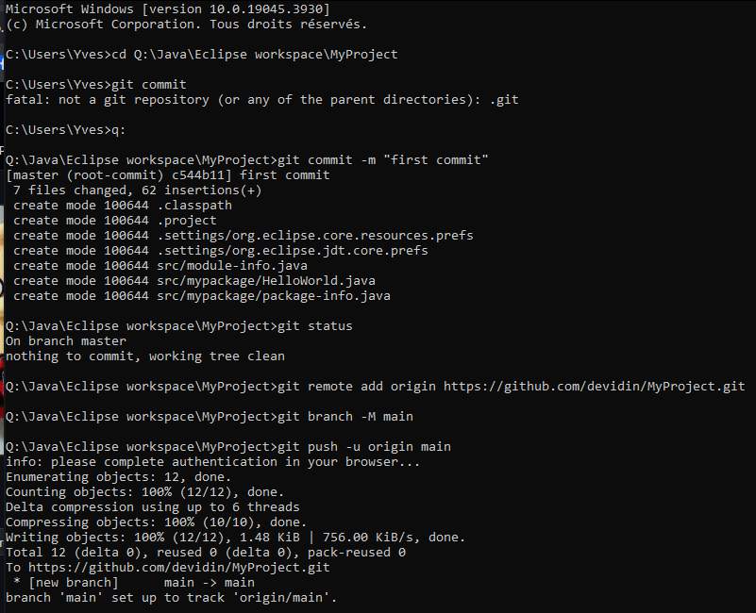
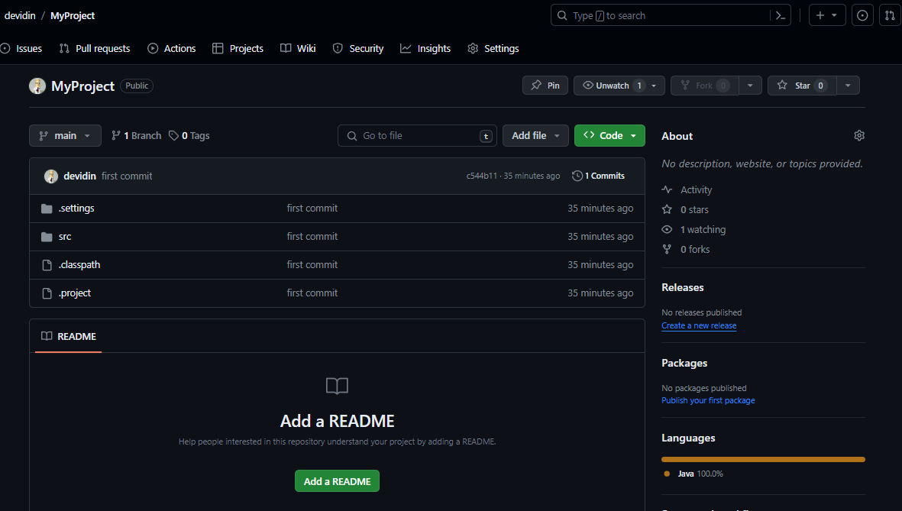
GitHub : start from scratch

Slide 9
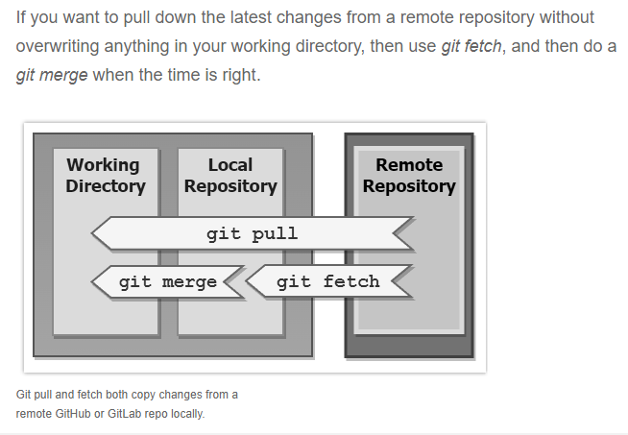
Aligning code with github

Slide 10
Limitations
Requires logging → integrate with log4J or equivalent
Requires configuration

Slide 11
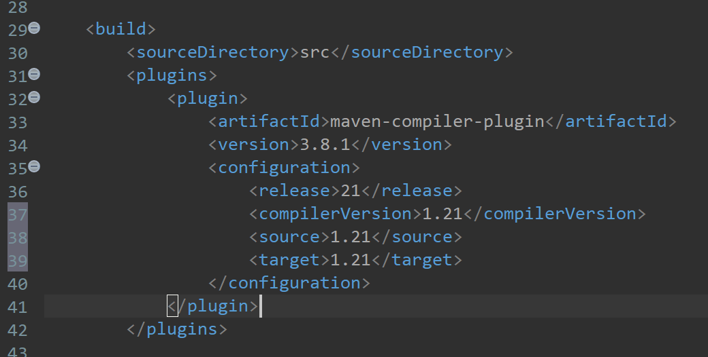
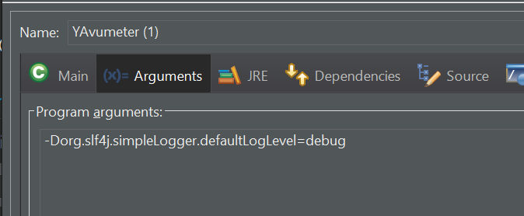
Logging
Alternatives: Log4j, Log4j 2, Logback+ SL4J (https://www.baeldung.com/java-logging-intro)
Selection: SL4J+Logback because provides a common interface and abstraction for most of the Java logging frameworks. https://www.baeldung.com/logback
Requires to convert to Maven project
Specify compilation option in pom.xml:
Configure SL4J/logback: https://logback.qos.ch/setup.html

Slide 12
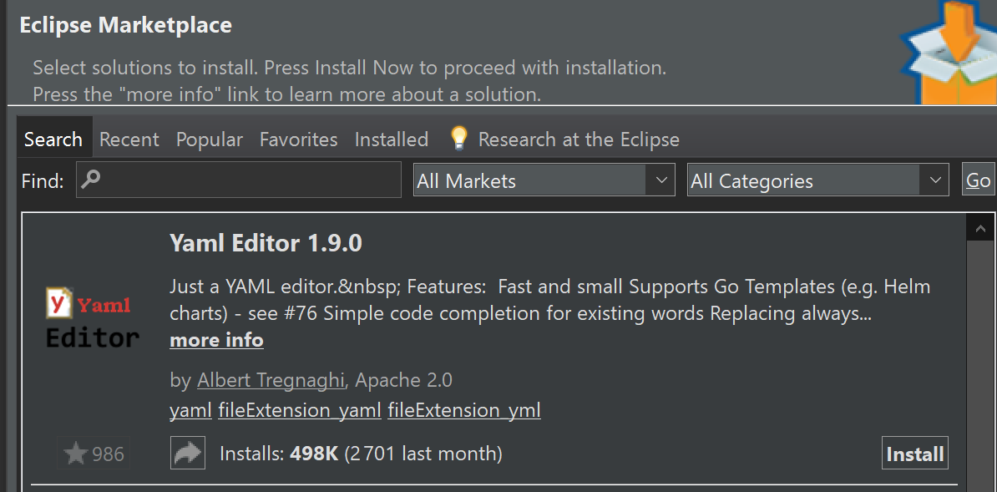
Configuration
Selected solution: snakeyaml
Eclipse plugin :
https://marketplace.eclipse.org/content/liclipsetext
Note: https://github.com/de-jcup/update-site-eclipse-yaml-editor/tree/main is not working... (failed to connect from eclipse)

Slide 13
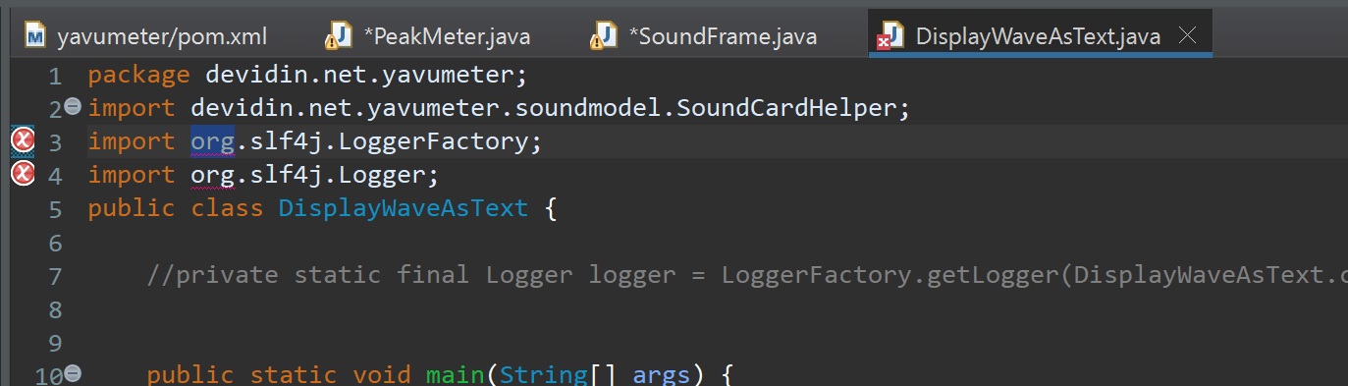
Libraries not accessible

Slide 14
Step 3 – Graphical representation
Console output too slow → requires graphical representation (cf.
Console output too slow → requires graphical representation (cf.
GUI Framework: JavaFX

Slide 15
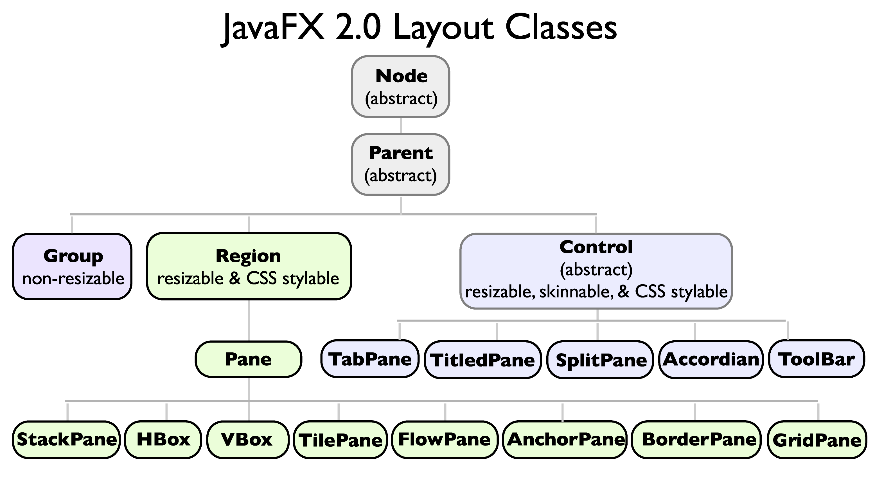
JavaFX components
Stage: container
https://medium.com/@rafaelgurgel/javafx-basic-concepts-9b40c271e78a#:~:text=JavaFX%20has%20works%20with%20four,%2C%20Scene%2C%20Node%20and%20Layout.&text=Is%20the%20central%20element%2C%20acting,space%20where%20everything%20happens%20inside
Scene: group of nodes
Scene: group of nodes
Scene: group of nodes
Scene: group of nodes
Layout: how to show nodes & elements
Layout: how to show nodes & elements
Layout: how to show nodes & elements
UIcontrol: label, button, …
UIcontrol: label, button, …
UIcontrol: label, button, …

Slide 16
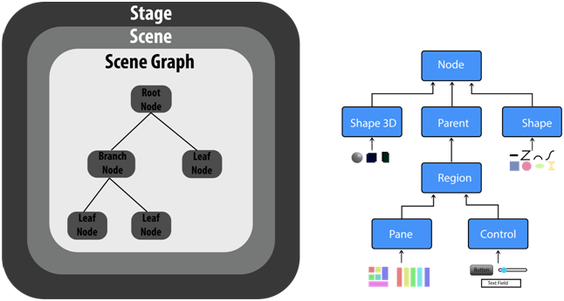

Slide 17
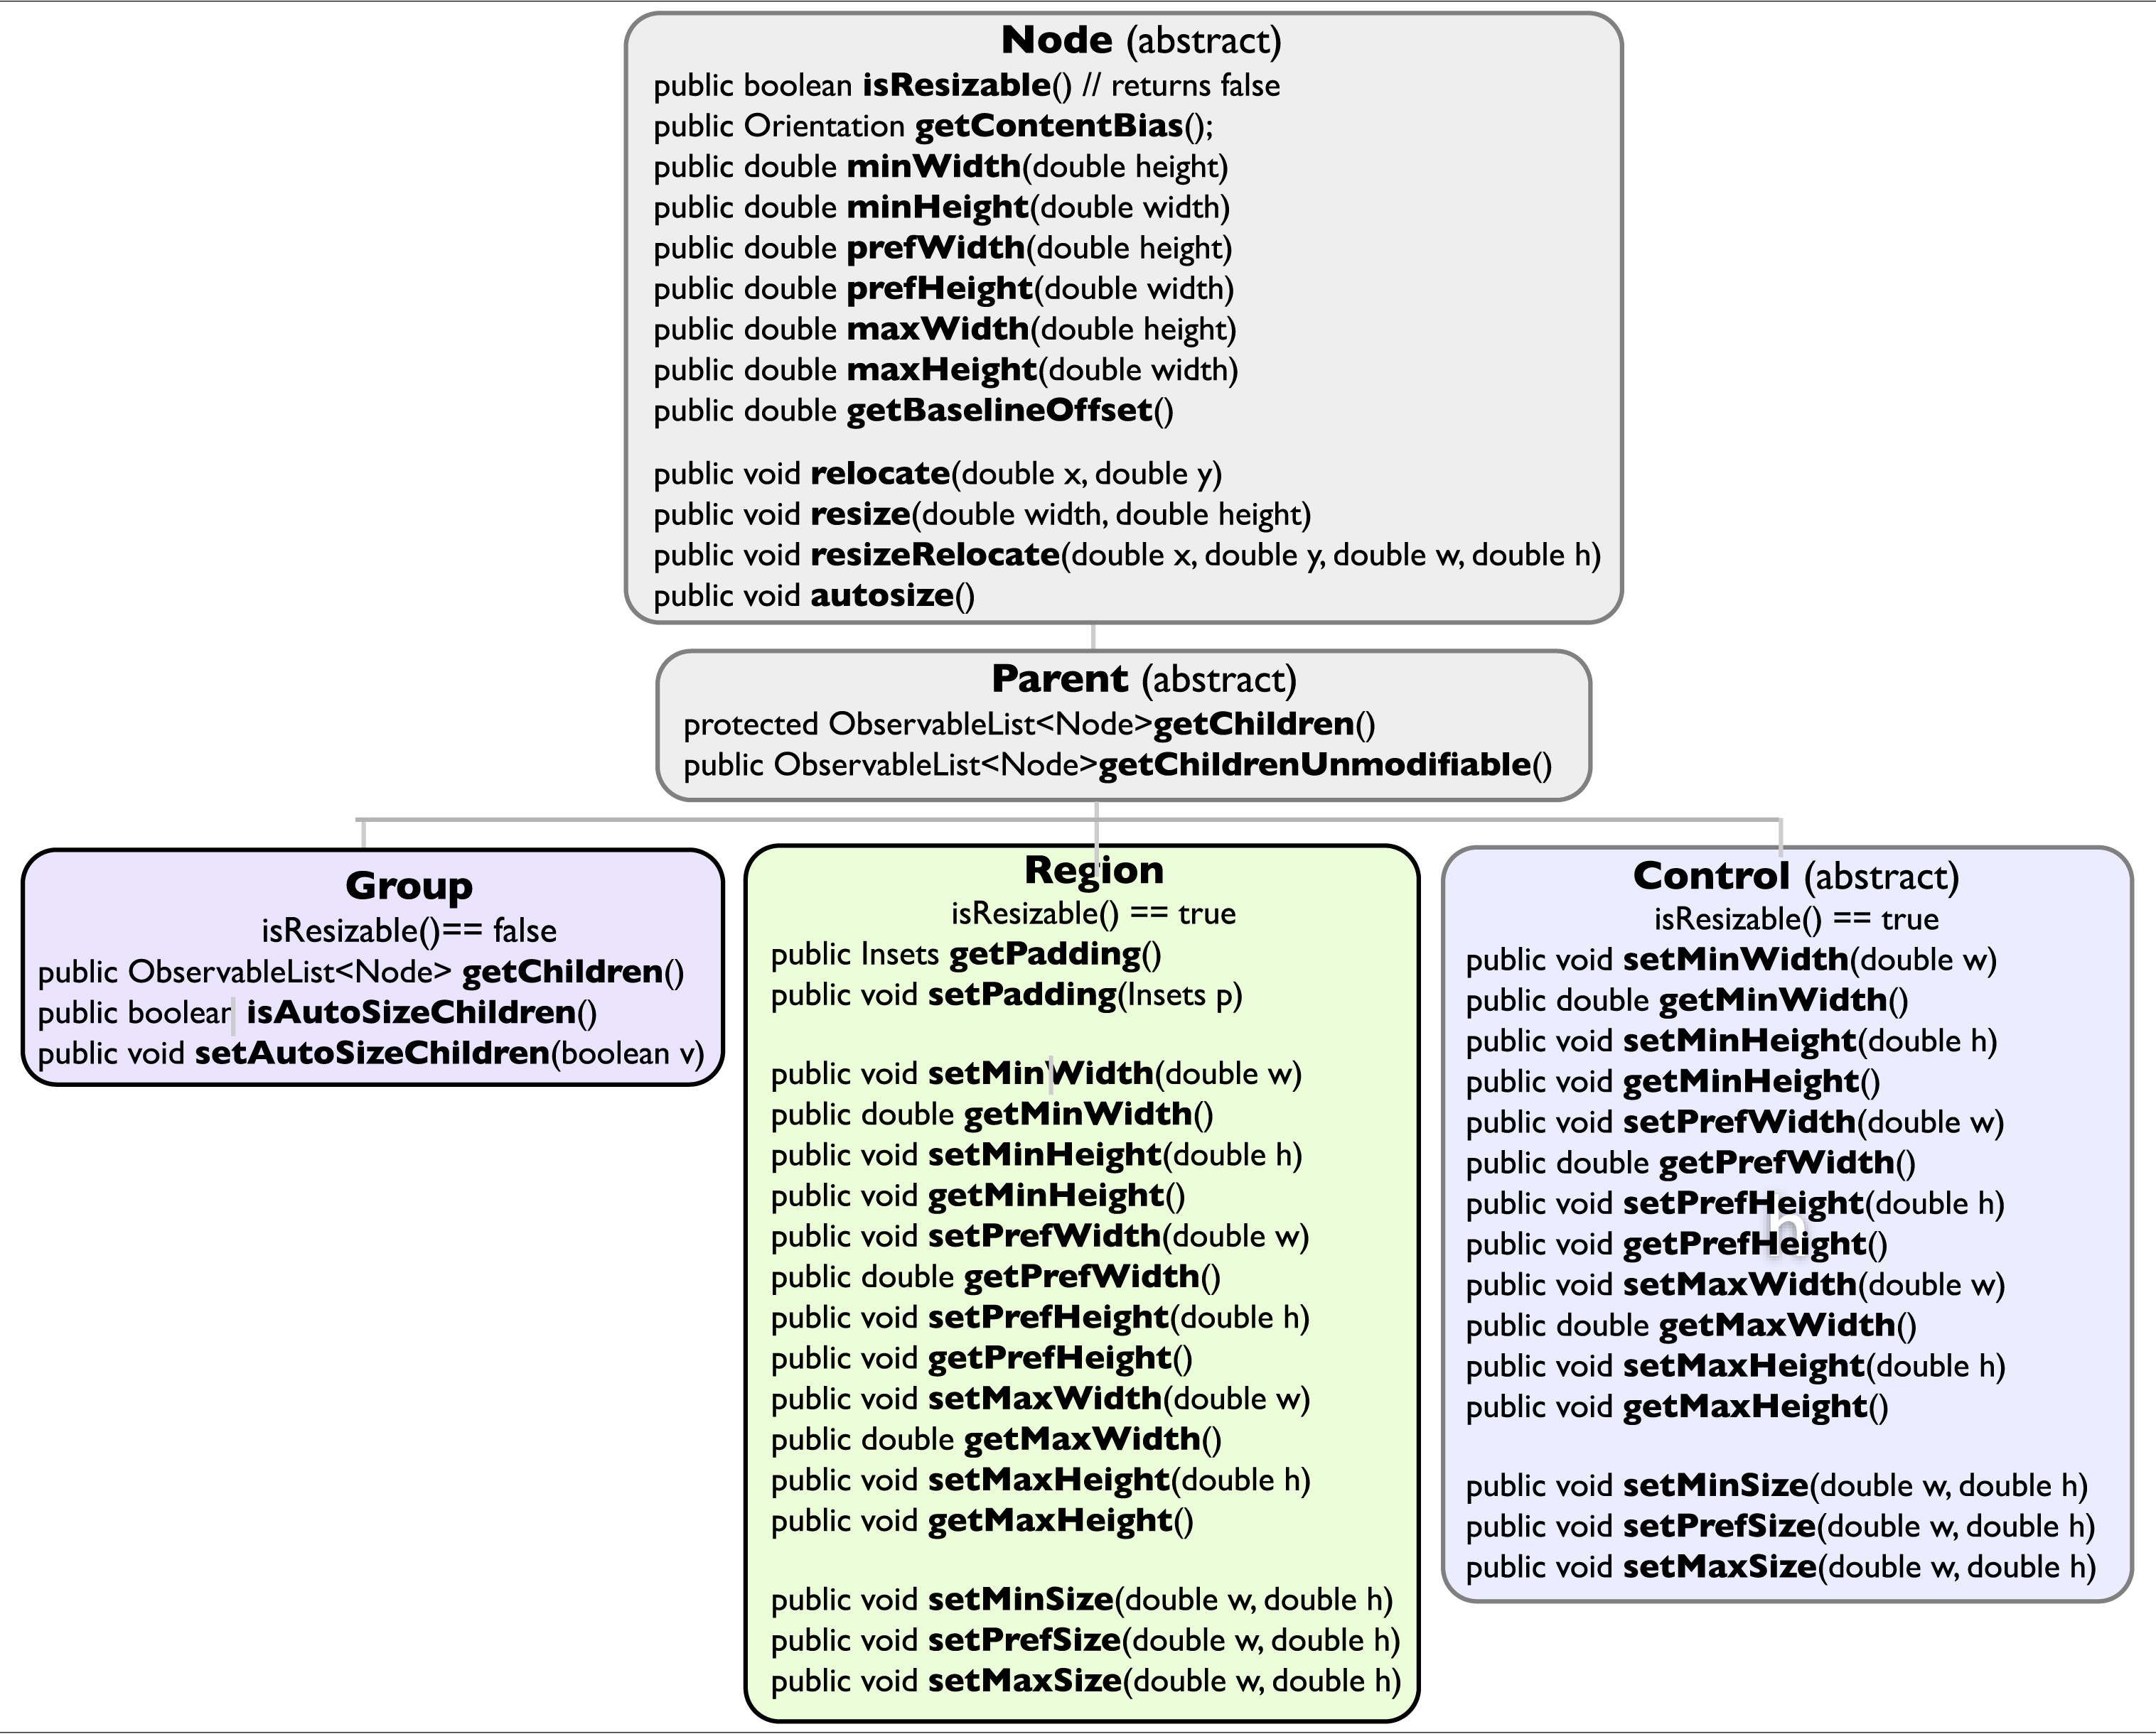

Slide 18
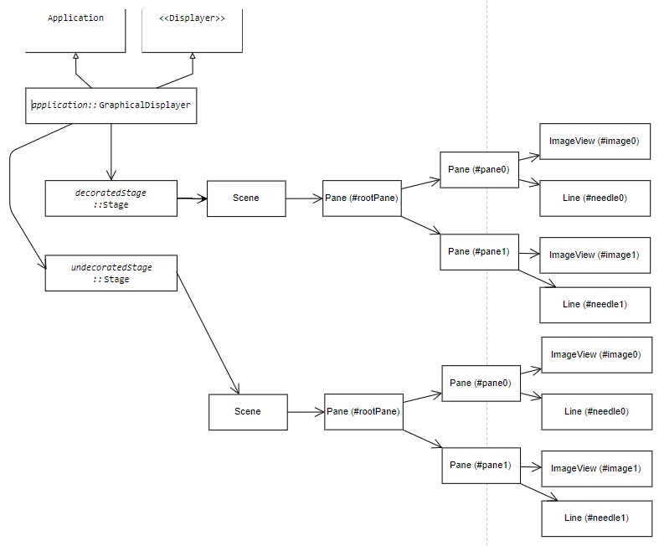
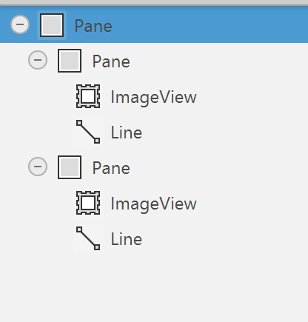
Javafx class diagram
FMX
https://gitmind.com/app/docs/f64imf33

Slide 19
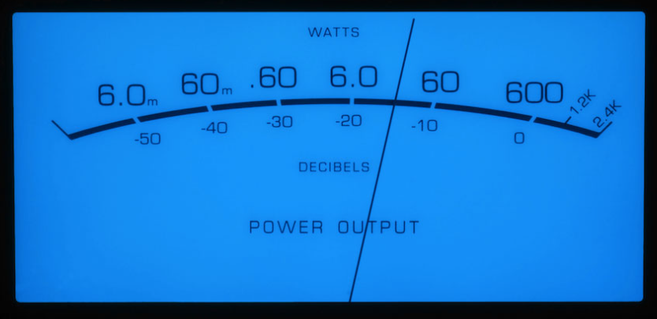
Graphical representation - layout
height
needleLength
minAngle
width
maxAngle

Slide 20
Graphical representation - coordinates
(0,0)
needleLength
Min (xMin, yMin)
Max (xMax, yMax)
minAngle
height
width
maxAngle
C (xC, yC)

Slide 21
Graphical representation - calculations
Input
Background → width, height
Configuration
xC (default = width/2)
yC (default = -height / 5)
xMin (default = witdh/10)
yMin (default = height/3)
xMax (default = 9*width/10)
yMax : (default = 9*width/10)
needleRed = 0..255 (default = 0)
needleGreen = 0..255 (default = 0)
needleBlue = 0..255 (default = 0)
Calculations
needleLength = avg(sqrt( (xMin-xC)² + (yMin-yC)² ), sqrt( (xMax-xC)² + (yMax-yC)²)
(redundant inputs, possibly 2 different needle lengths → use average)
minAngle = arccos((xMin – xC) / needleLength)

Slide 22
Graphical representation - coordinates
Min (xMin, yMin)
→ Use atan2()
minAngle
xMin – xC
cosMin =
needleLength
needleLength
C (xC, yC)

Slide 23
Graphical representation - coordinates
Max (xMax, yMax)
→ Use atan2()
yMax – yC
sinMax =
needleLength
maxAngle
needleLength
C (xC, yC)

Slide 24
Min (xMin, yMin)
minAngle
C (xC, yC)
→ Use atan2()
xMin – xC
cosMin =
needleLength
needleLength

Slide 25
C (xC, yC)
→ Use atan2()
maxAngle
xMax – xC
cosMax =
needleLength
needleLength
Max (xMax, yMax)

Slide 26
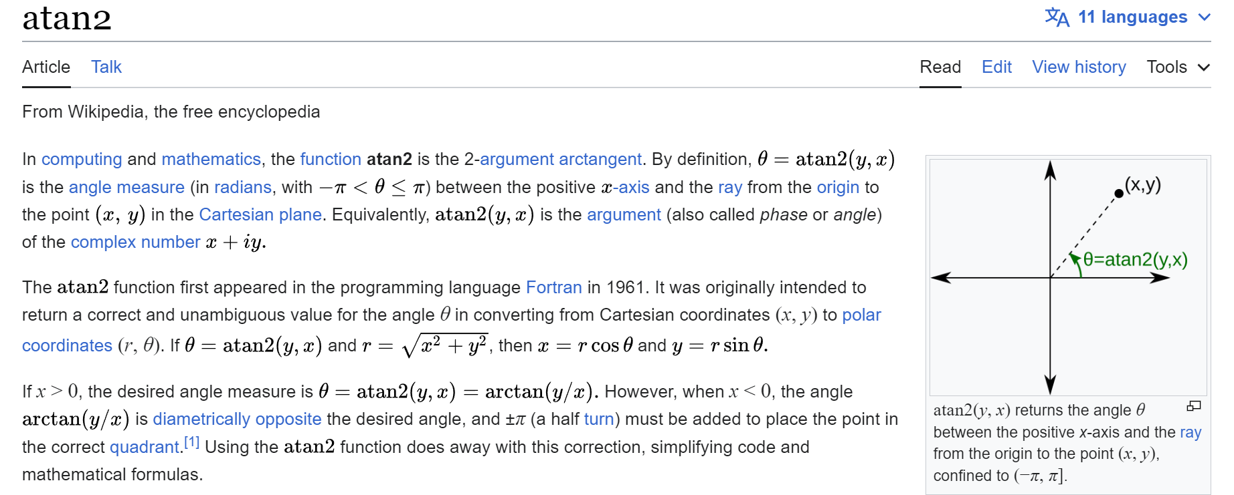
Graphical representation - calculations
Calculations
maxAngle = arccos((xMax – xC) / needleLength)
or
maxAngle = arcsin((yMax – yC) / needleLength)
yMax = yC + needleLength * sin (maxAngle)
https://en.wikipedia.org/wiki/Atan2
max(min)Angle = atan2(yMax(Min) – yC, xMax(Min)– xC)

Slide 27
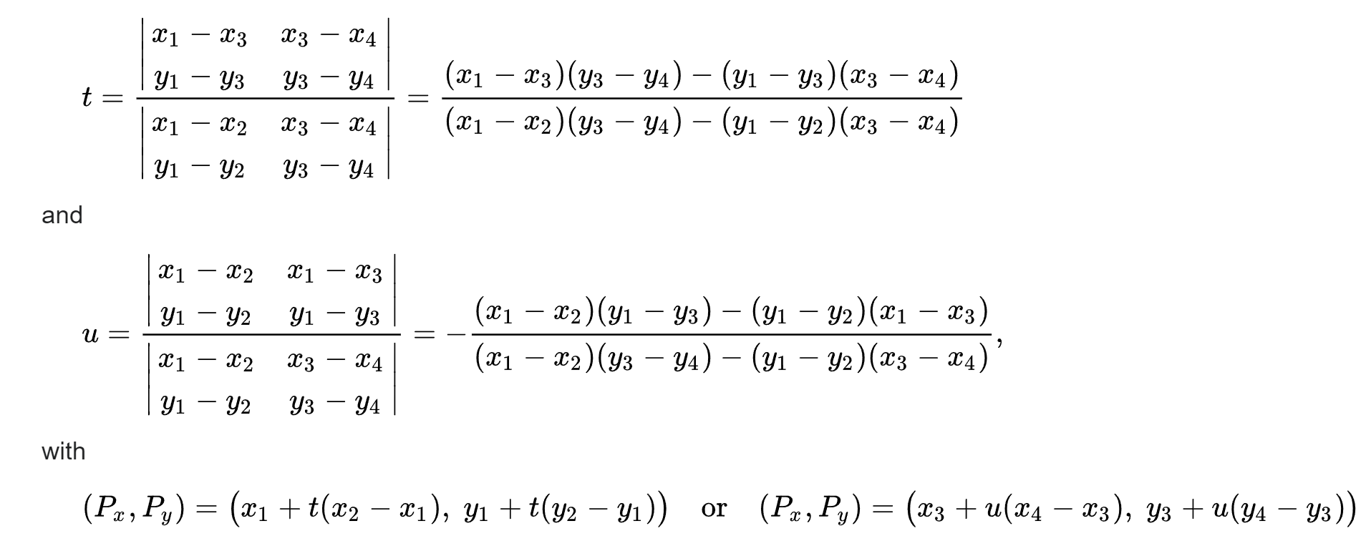
Intersection of 2 segments
(x4,y4)
https://en.wikipedia.org/wiki/Line%E2%80%93line_intersection
(x2,y2)
(x1,y1)
(xI,yI)
denominator
(x3,y3)
// Calculate the intersection point of two line segments
public static double[] calculateIntersection(double x1, double y1, double x2, double y2,
double x3, double y3, double x4, double y4) {
double[] intersection = new double[2];
double denominator = (x1 - x2) * (y3 - y4) - (y1 - y2) * (x3 - x4);
// Check if the lines are parallel (denominator is zero)
if (denominator == 0) {
return null; // No intersection
}
double t = ((x1 - x3) * (y3 - y4) - (y1 - y3) * (x3 - x4)) / denominator;
double u = -((x1 - x2) * (y1 - y3) - (y1 - y2) * (x1 - x3)) / denominator;
// Check if the intersection point is within the line segments
if (t >= 0 && t <= 1 && u >= 0 && u <= 1) {
intersection[0] = x1 + t * (x2 - x1);
intersection[1] = y1 + t * (y2 - y1);
return intersection;
} else {
return null; // Intersection is outside the line segments
}
}

Slide 28
Graphical representation – drawing needle
(0,0) – (0,0)
(width, 0)
(dX, dY)
maxAmplitude = 2^{bitPerFrame-1}
μ = (maxAngle-minAngle)
α = minAngle + amplitude * μ / maxAmplitude
X = xC + cos(α) * needleLength
Y = yC + sin(α) * needleLength
(xI, YI) = calculateIntersection(0,height, width,height, xC,yC, X,Y)
… if null → (xC, yC)
(dX, dY) = ( X * dWidth/width, Y * dHeight/height )
(dXi, dYi) = ( xI * dWidth/width, yI * dHeight/height )
Draw area
(dXi, dYi)
(dWidth, dHeight)
μ
(X, Y)
0
α
max
image
(xI, yI)
(0, height)
(width, height)
(xC, yC)

Slide 29
Smooth move
Refresh every 0,02s (1/50s = 50Hz) (do not wait for full buffer)
Define maximum pixels change up and down for each call (maxUpSpeed, maxDownSpeed)
Reach next measure progressively

Slide 30
Needle inertia
downSpeed
upSpeed

Slide 31
Avoid Flickering
if (segment != null) {
Platform.runLater(() -> {
needle.setStartX(segment[0]);
needle.setStartY(segment[1]);
needle.setEndX(segment[2]);
needle.setEndY(segment[3]);
needle.setVisible(true);
});
} else {
needle.setVisible(false);
}
https://stackoverflow.com/questions/34345019/javafx-animations-are-flickering
https://stackoverflow.com/questions/64291358/how-to-enable-platform-runlater-within-method

Slide 32
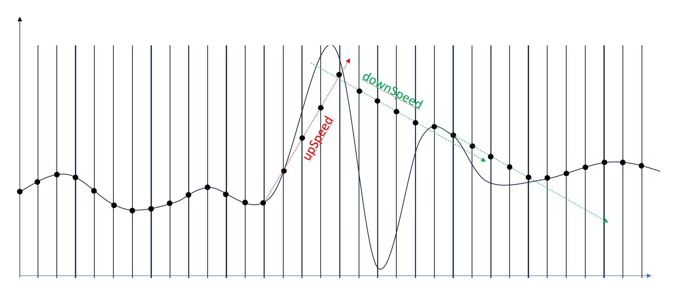
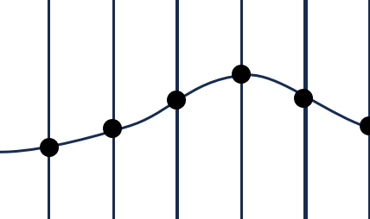
Smoothing

Slide 33
Background design

Slide 34
Background
-7
-5
-3
-1
0
-10
⁺1
⁺2
-20
⁺3
P O W E R L E V E L
D E C I B E L S

Slide 35
Background
-7
-5
-3
-1
0
-10
⁺1
⁺2
-20
⁺3
P O W E R L E V E L
D E C I B E L S

Slide 36
Background
-7
-5
-3
-1
0
-10
⁺1
⁺2
-20
⁺3
P O W E R L E V E L
D E C I B E L S

Slide 37
Background - blue
-7
-5
-3
-1
0
-10
⁺1
⁺2
-20
⁺3
P O W E R L E V E L
D E C I B E L S

Slide 38
-5
-3
-1
-7
0
-10
⁺1
⁺2
-20
⁺3
P O W E R L E V E L
D E C I B E L S

Slide 41
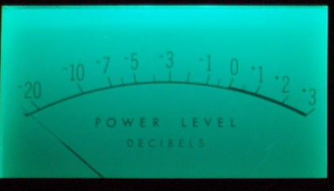
Background - green
-7
-5
-3
-1
0
-10
⁺1
⁺2
-20
⁺3
P O W E R L E V E L
P O W E R L E V E L
D E C I B E L S
D E C I B E L S

Slide 42
-5
-3
-1
-7
0
-10
⁺1
⁺2
-20
⁺3
P O W E R L E V E L
D E C I B E L S

Slide 43
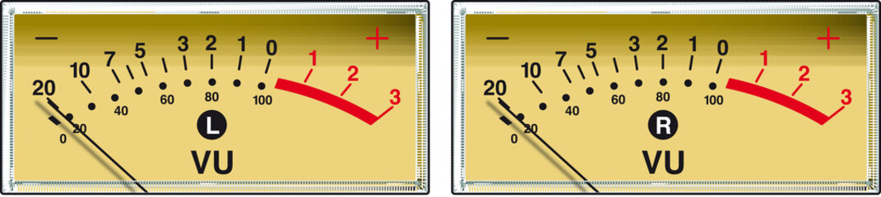
Background - yellow
-7
-5
-3
-1
0
-10
⁺1
⁺2
-20
⁺3
P O W E R L E V E L
P O W E R L E V E L
D E C I B E L S
D E C I B E L S

Slide 44
-5
-3
-1
-7
0
-10
⁺1
⁺2
-20
⁺3
P O W E R L E V E L
D E C I B E L S

Slide 45
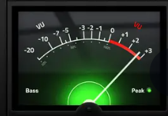
Background - black
-7
-5
-3
-1
0
-10
⁺1
⁺2
-20
⁺3
P O W E R L E V E L
P O W E R L E V E L
D E C I B E L S
D E C I B E L S

Slide 46
-5
-3
-1
-7
0
-10
⁺1
⁺2
-20
⁺3
P O W E R L E V E L
D E C I B E L S

Slide 47
Background - white
-7
-5
-3
-1
0
-10
⁺1
⁺2
-20
⁺3
P O W E R L E V E L
P O W E R L E V E L
D E C I B E L S
D E C I B E L S

Slide 48
-5
-3
-1
-7
0
-10
⁺1
⁺2
-20
⁺3
P O W E R L E V E L
D E C I B E L S

Slide 49
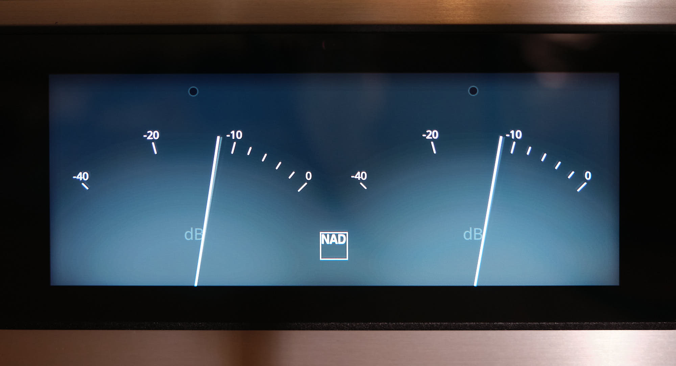
NAD - Grey
-10
-20
-40
0
NAD
dB

Slide 50
-10
-20
-40
0
NAD
dB

Slide 51
NAD - white
-10
-20
-40
0
NAD
dB

Slide 52
-10
-20
-40
0
NAD
dB

Slide 54
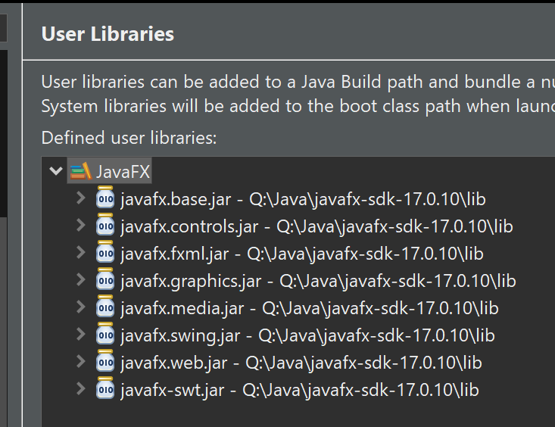
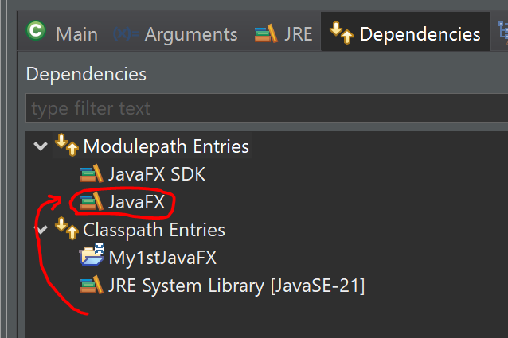
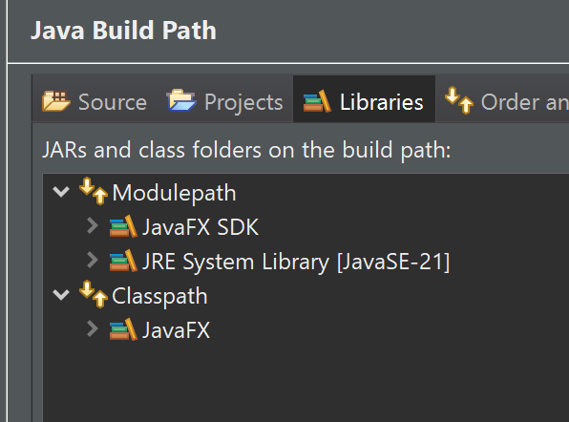
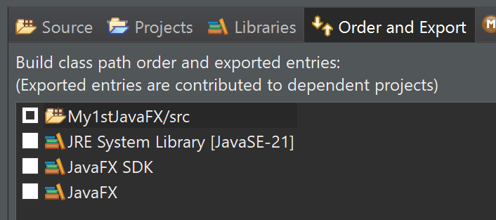
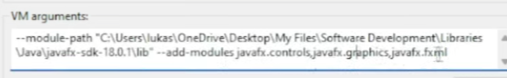
JavaFX
Integration with Eclipse: cf. https://www.youtube.com/watch?v=bk28ytggz7E
https://www.youtube.com/watch?v=nz8P528uGjk
Download SKD: https://openjfx.io/
:
! Delete module-info from generated project

Slide 55
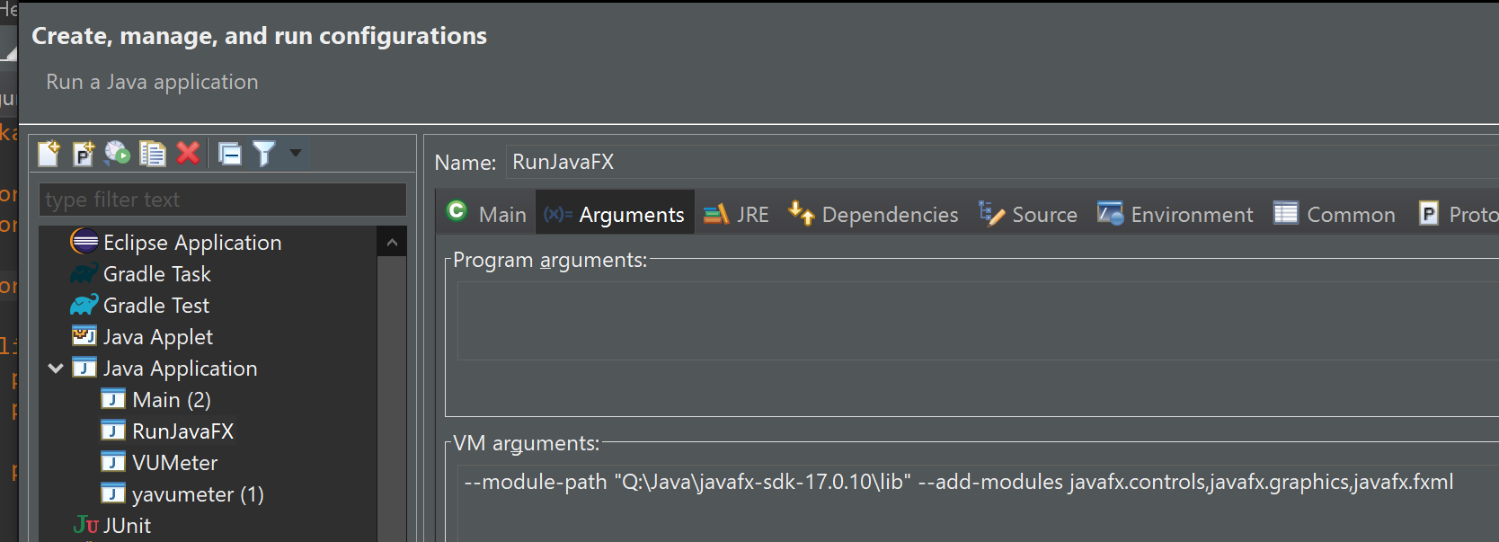
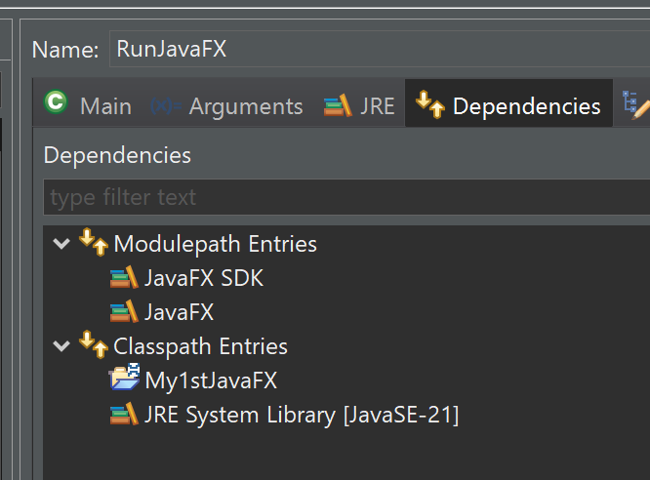
Run configuration

Slide 56

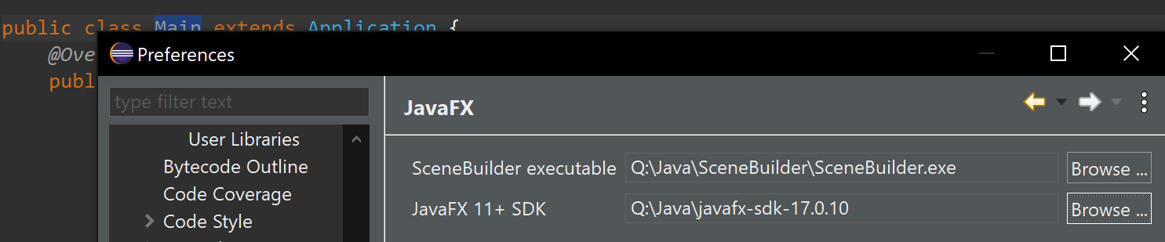
Screen design – Scene Builder
Install:
https://www.youtube.com/watch?v=cfGTJVVcWvE&list=PLpFneQZCNR2ktqseX11XRBc5Kyzdg2fbo
Use:
https://www.youtube.com/watch?v=HBBtlwGpBek
https://www.youtube.com/watch?v=q5A-qW2eGKs&list=PLpFneQZCNR2ktqseX11XRBc5Kyzdg2fbo&index=2

Slide 57
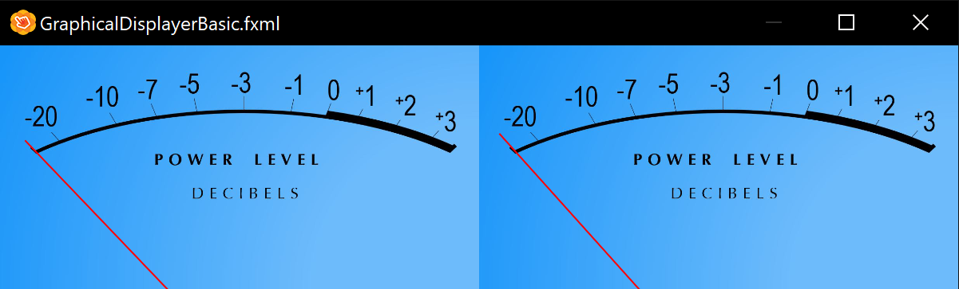
First result…

Slide 58
UML
gitmind
https://gitmind.com/app/docs/f64imf33

Slide 59
Release
Build, Release, Publish, install on another machine from github

Slide 60
OSGi
To evaluate..

Slide 61
Step 4 – C/S model (angular+Spring)
GUI Framework: Angular
Server : swing
TODO

Slide 62
Step 5 – Mobile
Reverse client/server model (like X-windows)?
Framework: ??
TODO

Slide 63
Bypass VoiceMeter
Integrate custom Java interface with some C++ library or custom dev to directly access a selected output device (target mixer) instead of redirecting output with VoiceMeter to a virtual microphone

